Slide 1

OPS Lecture 2:
Digital vs. Analog, and PWM
V1.1
Notes:
Changelist
1.1
Minor changes to remove references to Lecture 5.
1.0
Initial Release

Slide 2
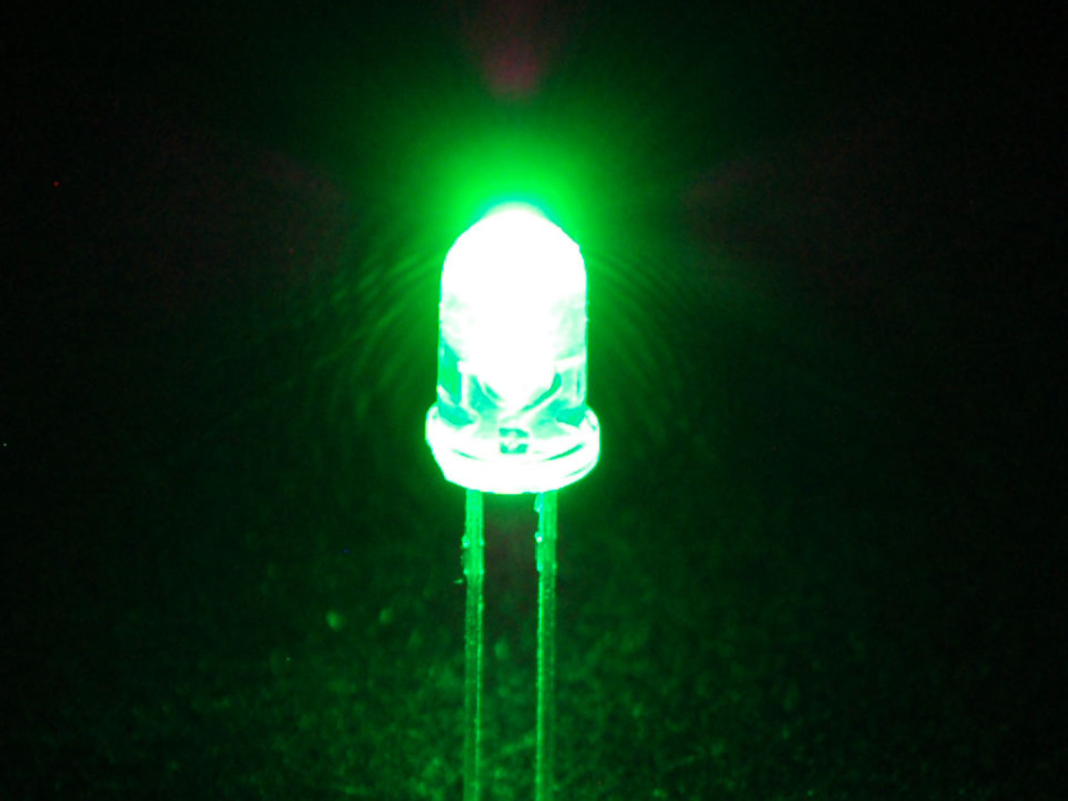
Recall from last project...
We used digitalWrite to turn LED on/off
We used analogRead to read voltage across potentiometer
But what does the analog/digital part mean?

Slide 3
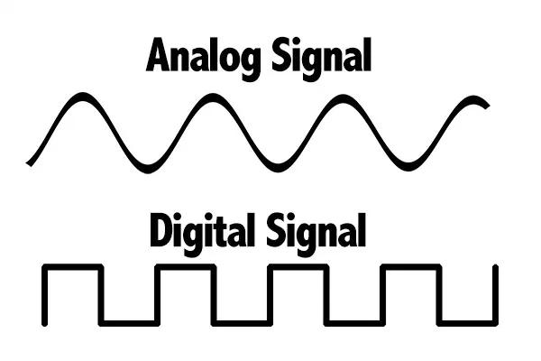
Digital vs. Analog
Analog: a smooth, continuous range of values (0~1023 read in arduino program)
Digital: discrete values, either ON or OFF (HIGH or LOW in the arduino program)
In Arduino we read pins for input and write to pins to output
Notes:
Bryan

Slide 4
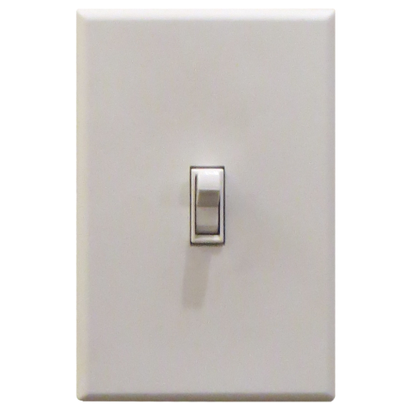
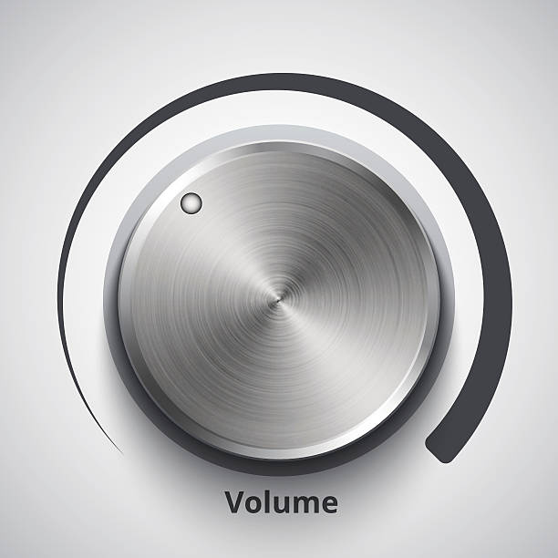
Pop Quiz: Analog or Digital?
Light Switch
Answer: Input/Output are digital
Physical Switch/ Lightbulb is either ON or OFF
Volume Dial
Answer: Input/Output are analog
Volume is a continuous value
Notes:
Bryan

Slide 5

Pop Quiz: Another Case
Converting percentage score into a letter Grade (As are 90-100, Bs are 80-90)
Is this an Analog or Digital System?
A | [90, 100]
B | [80, 90)
Notes:
Bryan

Slide 6
Pop Quiz: Another Case
Converting percentage score into a letter Grade (As are 90-100, Bs are 80-90)
Is this an Analog or Digital System?
Answer: BOTH! Input is Analog (Score is from 0-100) but Output is Digital.
INPUT: Score is 94 → OUTPUT: Grade ISN’T a B, Grade IS an A
We will use this sort of logic in the project later.
 | A? | B?
[90, 100] | YES | NO
[80, 90) | NO | YES
Notes:
Bryan

Slide 7
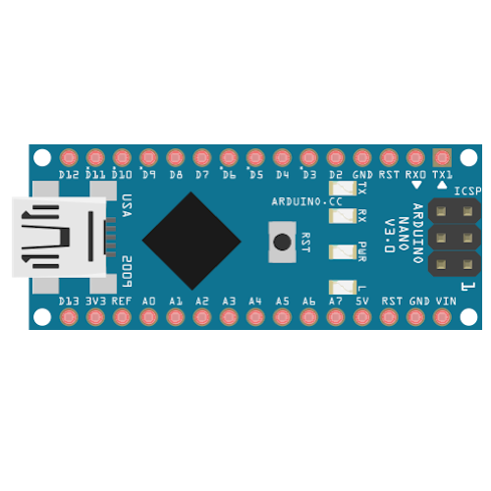
Reminder from lecture 1:
(MCUs)
Arduino Nano
Essentially a small programmable computer that can coordinate different input/output functions in your circuit
ex: read temperature sensor and turn a fan motor accordingly, RC car, etc.
Connects to your circuit via different pins
Analog INPUT pins
Digital INPUT/OUTPUT pins
Digital PWM OUTPUT Pins (Analog OUTPUT)
Code (C++ in this case) controls hardware

Slide 8
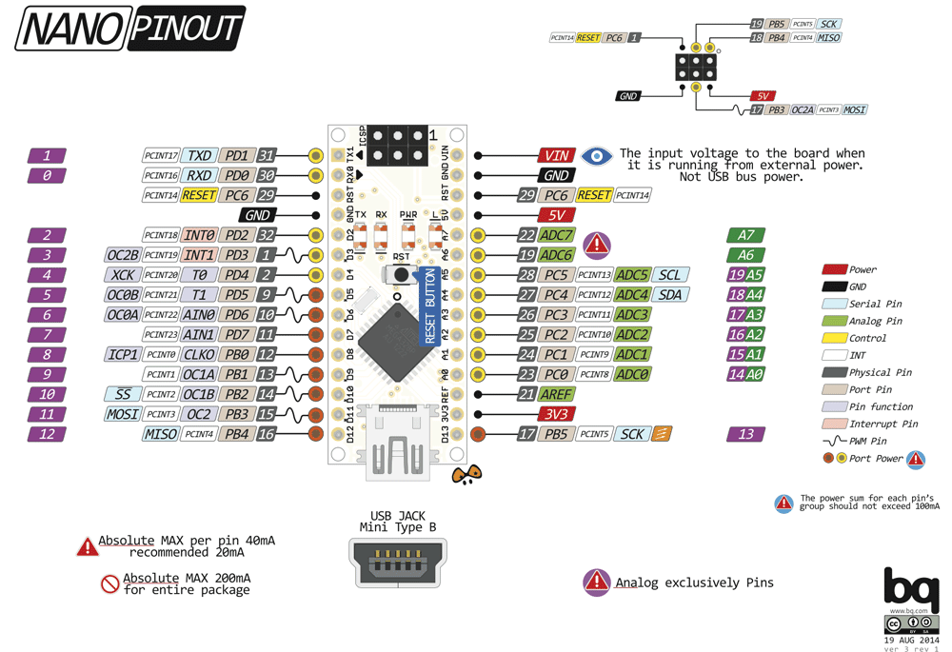
For now, we’ll focus only on these pins:
The numbers/names in purple/dark green are recognized by the Arduino programming software. We will need this!

Slide 9
Reading from/Writing to Digital pins
Digital
digitalRead(pin#): reads voltage at pin, returning HIGH or LOW
digitalWrite(pin#, [HIGH/LOW]): sets voltage on pin to either HIGH (5V) or LOW (0V)
Example use case: Light switch (Either MAX brightness or MIN brightness)
*Common newbie mistake: make sure you pinMode!
Notes:
Note: The reason input voltages are compared from 0 to 5V is because 5V is the operating voltage of the Arduino and 0V is GND.

Slide 10
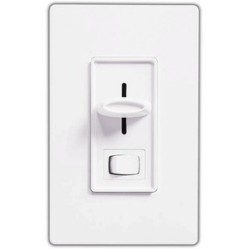
Reading from/Writing to Analog pins
analogRead(pin#): reads voltage at pin, and maps it to a value from the continuous range 0-1023 (0 for 0V, 1023 for 5V)
analogWrite(pin#, [0-255]): sets voltage on pin to a value from the continuous range 0 (0V) to 255 (5V)
Example use case: Light dimmer (Anywhere from min-max brightness)
On our Arduinos, this is a function for PWM pins only!
Analog
Notes:
Note: The reason input voltages are compared from 0 to 5V is because 5V is the operating voltage of the Arduino and 0V is GND.

Slide 11
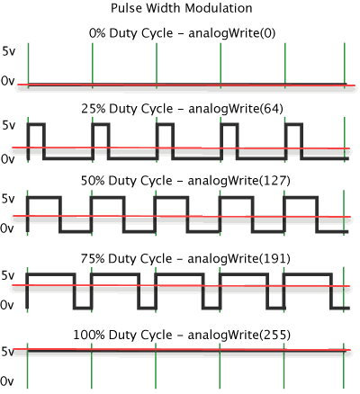
New Concept: PWM
The red line is the average value, which our components (LEDs, speakers, servo motors, etc.) will write!
Our Arduino is actually a digital source, meaning it can only output HIGH (5V) or LOW (0V)
How does analogWrite work?
PWM! (Pulse Width Modulation)
We can turn our digital output into an analog output
By inputting HIGH and LOW for different periods of time very quickly, the AVERAGE value over the cycle will be a value in between!
Notes:
Bryan

Slide 12
PWM cont.
The red line is the average value, which our components (LEDs, speakers, servo motors, etc.) will write!
The duty cycle of the PWM signal is the percentage of time where the signal is HIGH
In this case, a 50% duty cycle translates to an average value of 2.5V (50% of 5V)
Allows us to output a continuous range of voltages
Notes:
Bryan

Slide 13
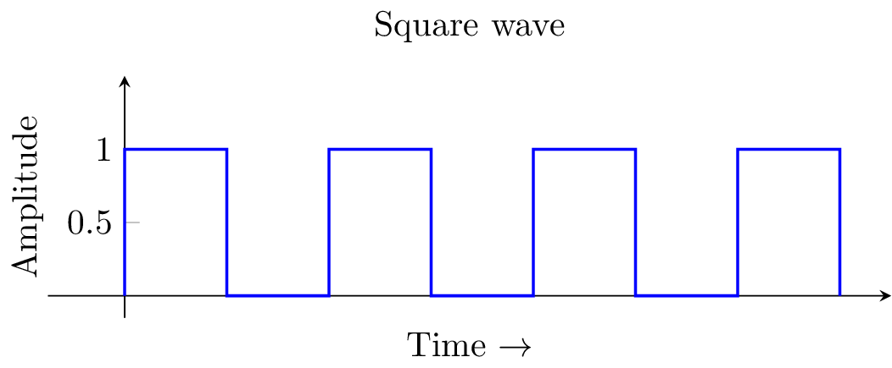
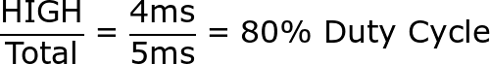
Pop Quiz Time!
PWM EditionTM
If our PWM wave pulses HIGH for 4 milliseconds and LOW for 1 millisecond, what is the duty cycle? If HIGH is 5V, what is the average voltage of our PWM wave?
Answer:
Average Voltage = (0.80)*(5V) = 4V
Notes:
Jackie

Slide 14

Example: PWM with and LED
What would an LED look like with 0% duty cycle?
It would be OFF
What would an LED look like with 100% duty cycle?
This means it would be HIGH the entire time!
Appear brightest compared to the other duty cycles

Slide 15
Example: PWM with and LED
If LED is HIGH(5V) for 2ms and LOW(0V) for 2ms, what is the PWM duty cycle?
HIGH/TOTAL = 2ms/4ms → 50% cycle
Avg Voltage = 0.5 * 5V = 2.5V
If LED1 has a 50% duty cycle and LED2 has a 80% duty cycle, which LED would be brighter?
LED2 since it has a larger duty cycle and avg voltage
Average Voltage = (0.80)*(5V) = 4V
**Note: To actually see a “dimming” effect on the LED, the frequency has to be high enough. If the LED was LOW for 2s and HIGH for 2s, it would only appear to be blinking, not actually dimmed!

Slide 16

Ex) Same duty cycle, different periods
50% duty cycle
small period & high freq
50% duty cycle
long period & low freq

Slide 17
PWM with analogWrite
Instead of being limited to turning an LED completely ON or OFF, we can choose the brightness with PWM
analogWrite(pin#, [0-255])
use PWM’s duty cycle to map to 0-255
digitalWrite(LED, HIGH) and analogWrite(LED, 255) are the same
digitalWrite(LED, LOW) and analogWrite(LED, 0) are the same
Notes:
255 is the max value: The voltage is kept HIGH the entire time with a 100% duty cycle
0 is the min value: The voltage is kept LOW the entire time with a 0% duty cycle

Slide 18
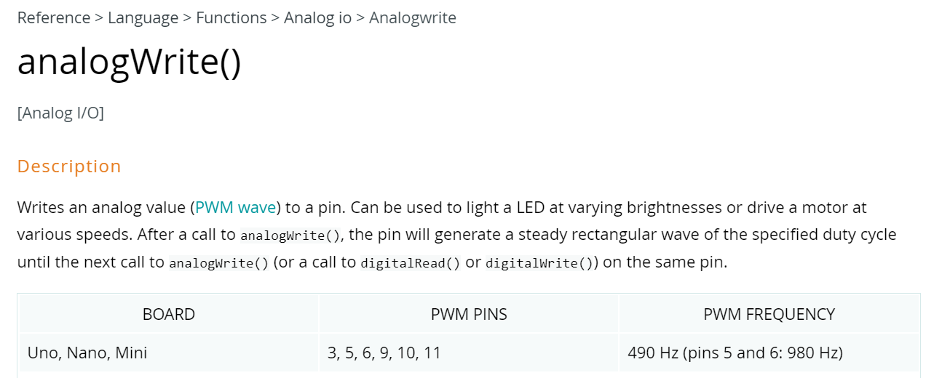
PWM with analogWrite
analogWrite() at one pin always has the same frequency!
Arduino analogWrite() page Link here
Notes:
255 is the max value: The voltage is kept HIGH the entire time with a 100% duty cycle
0 is the min value: The voltage is kept LOW the entire time with a 0% duty cycle

Slide 19
CS Basics
if-else statements

Slide 20
if statements
if(x) {
y;
}
If x is true, then all statements inside the brackets (such as y) will be executed
Example: If you are in OPS, finish Project 2

Slide 21
if statements - an example
if(analogRead(POT) > 500) {
digitalWrite(LED, HIGH);
Serial.print(“LED turned on!);
}
If the read voltage value at POT is greater than 500, then turn on the LED and print to monitor.

Slide 22
if-else statements
2 Different Possibilities
If x is true, then all statements inside the brackets (such as y) will be executed
If x is not true, then everything inside the else brackets (such as z) will be executed
if(x) {
y;
} else {
z;
}

Slide 23
Using if-else if statements for several states
4 Possibilities
Check if x1 is true. If it is false, check if x2 is true. If it is false, check if x3 is true, etc.
We can use this structure to test for a variety of different states
Alternatively, use a switch statement.
if(x1) {
y;
} else if(x2) {
z;
} else if(x3) {
w;
} else{
b;
}

Slide 24
if-else state selection example
if(x == 1) {
Serial.println(“January”);
} else if(x == 2) {
Serial.println(“February”);
} else if(x == 3) {
Serial.println(“March”);
} else {
Serial.println(“Not Jan, Feb, or March”); }
Given the number of a month, prints out its name.
Only one thing will ever be printed out.

Slide 25

Break - Questions?
New Concepts:
Difference between Digital/Analog Signals
PWM and Duty Cycles
CS if-else statements

Slide 26
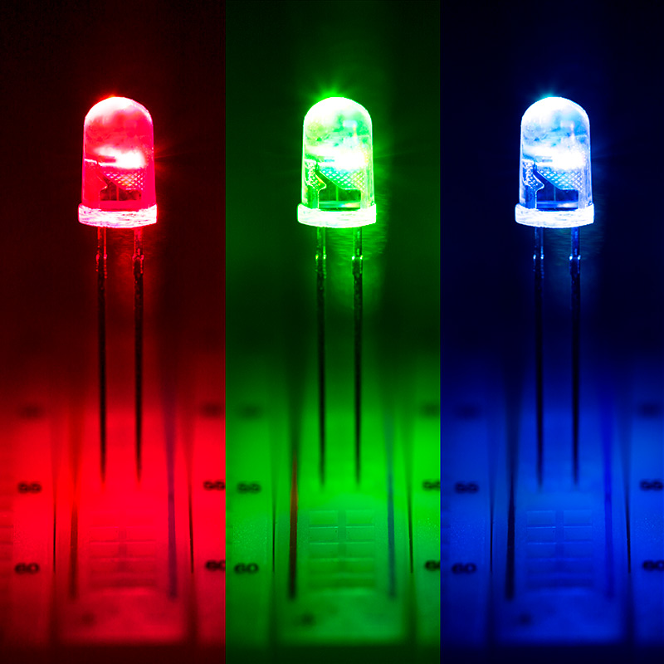
Mini project: Manually Create PWM
Change the brightness of an LED using only calls to the following two functions in loop():
digitalWrite(pin#)
delayMicroseconds(#us)
Hint: The frequency of your PWM wave should be 1 kHz, aka one wave every 1000 microseconds
Notes:
Bryan

Slide 27
Mini project: Manually Create PWM
Example video
make sure the total delay adds up to 1000 Microseconds!
Notes:
Bryan

Slide 28

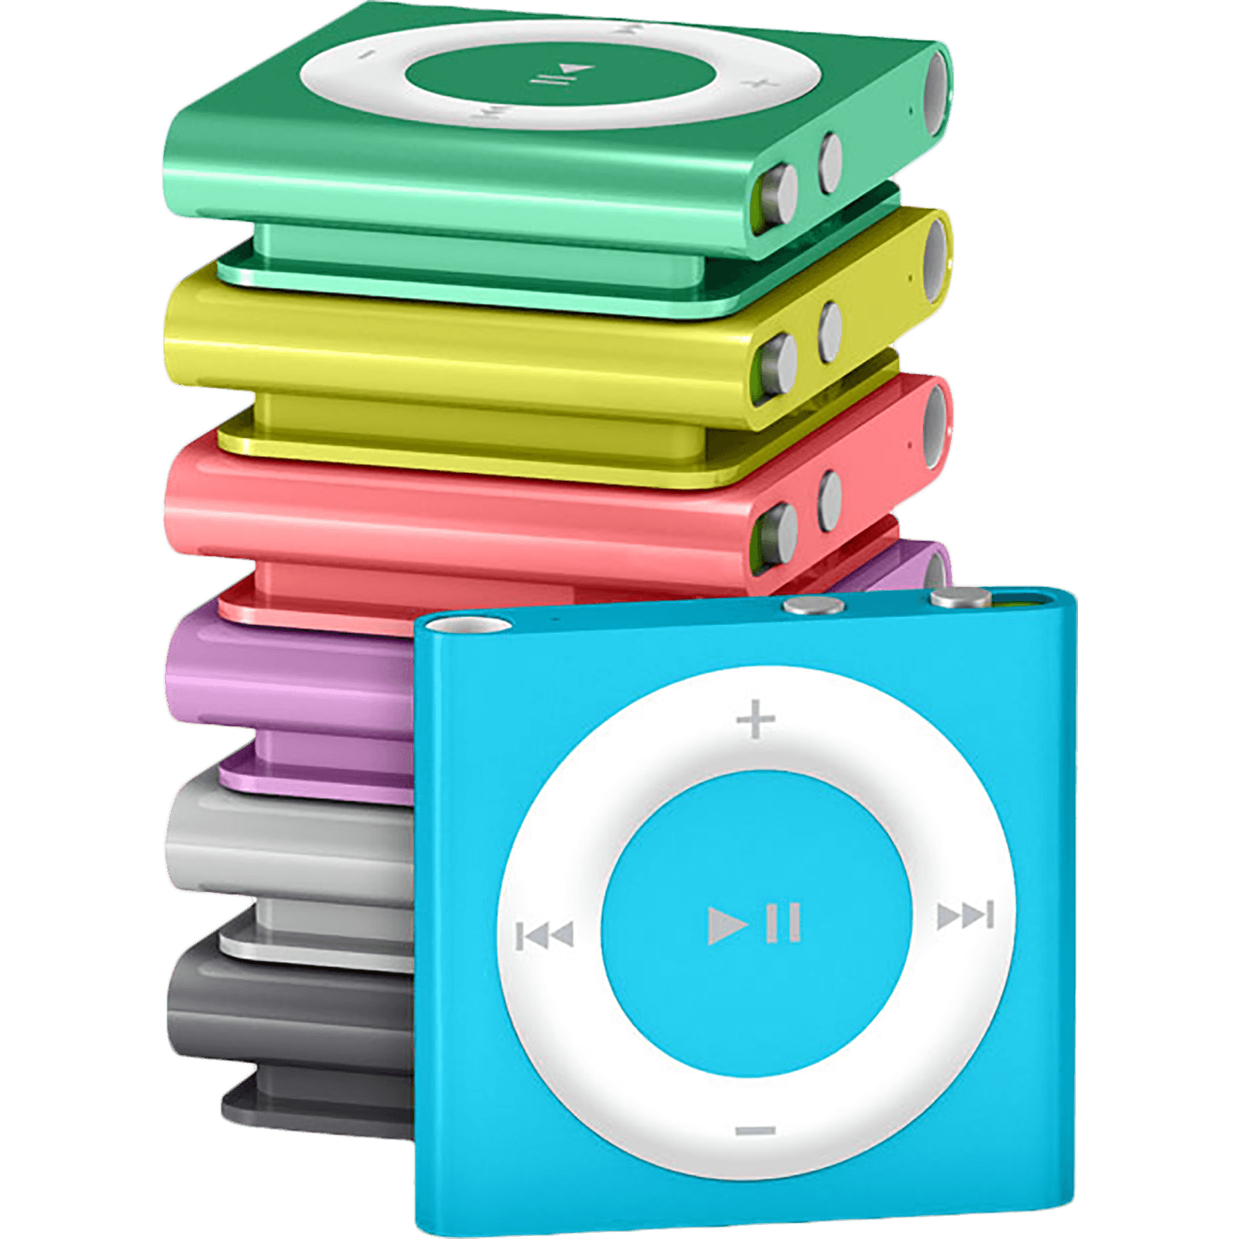
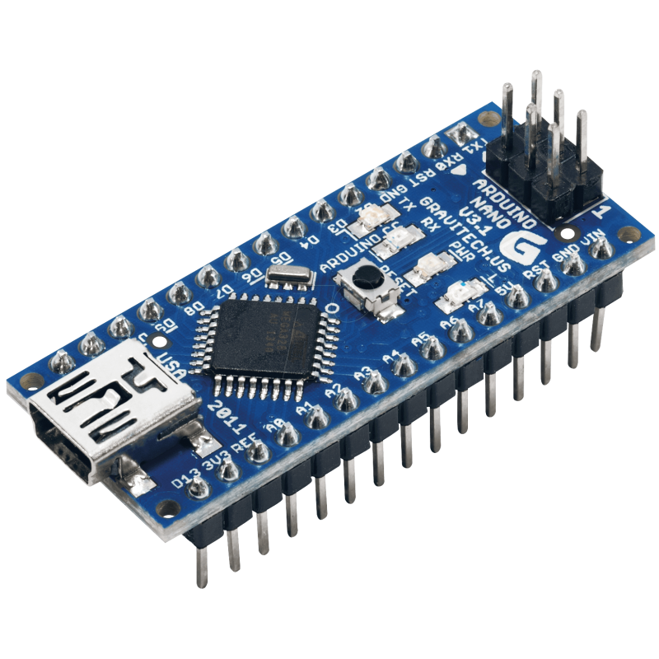
Introducing…
Project 2: the iPoduino (NANO)
Notes:
Bryan

Slide 29
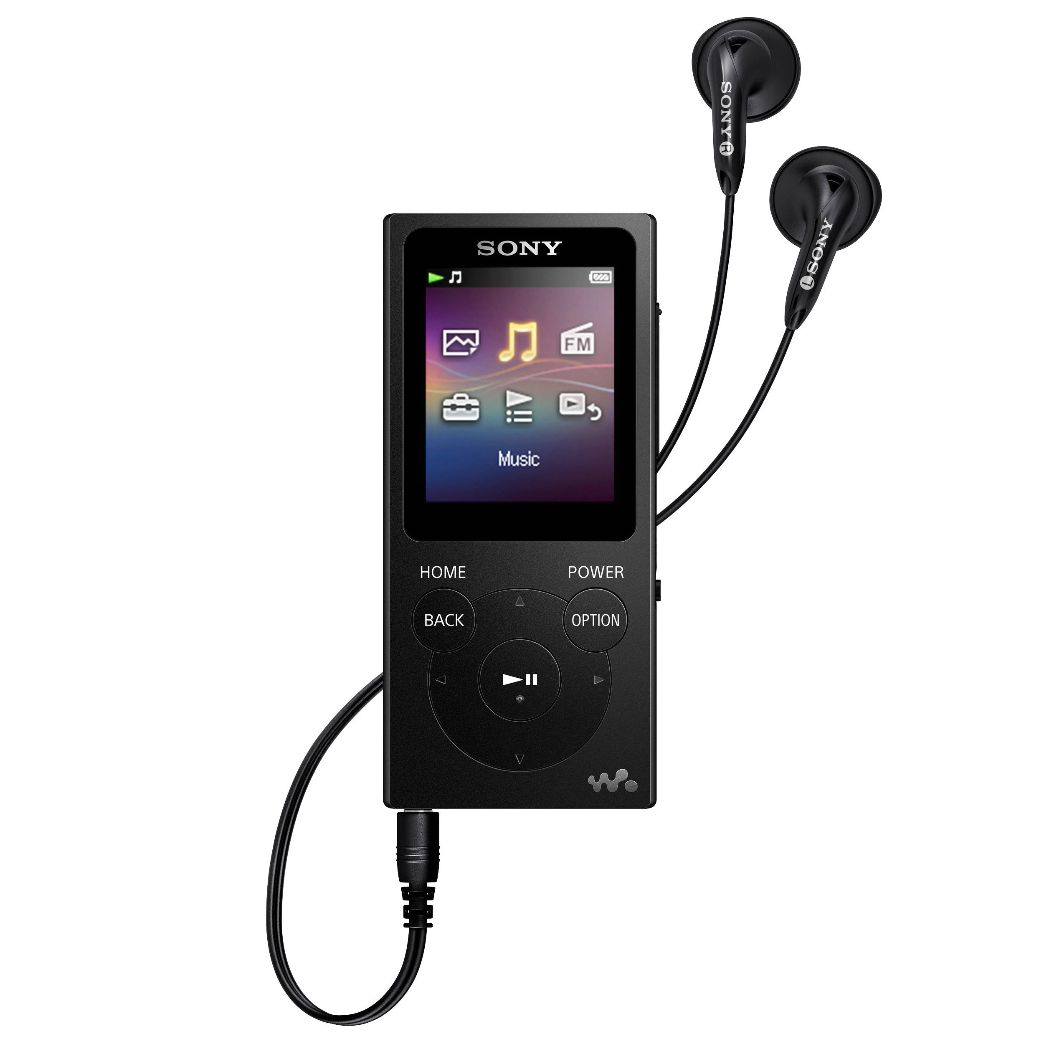
3 Main Features
SOUND: When the Arduino’s reset button is pressed, play bops through the speaker using PWM
We will use the tone() and noTone() Arduino functions
INTERFACE: Select song to be played using potentiometer dial
DISPLAY: LED that flashes with the song
Notes:
Bryan

Slide 30
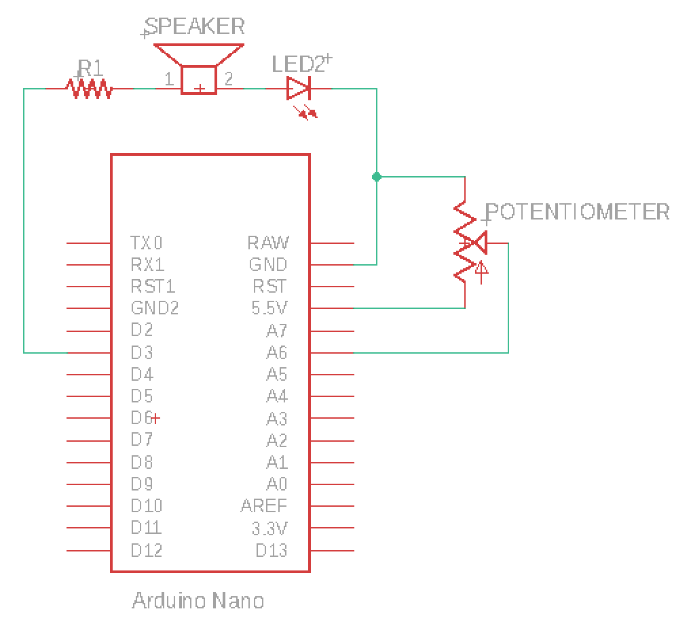
1. SOUND: Speaker and Music Visualization LED
2. INTERFACE: Song Selection
3. You will have to implement the DISPLAY yourself!
Notes:
Bryan

Slide 31
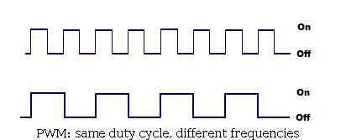
tone() and noTone()
tone(pin, frequency): generates a 50% duty cycle PWM square wave at specified frequency.
We get different notes by changing the frequency of the PWM wave
Higher frequency → Higher pitched note
noTone(pin): stops PWM wave generated by tone()
Notes:
Need a delay in between!

Slide 32
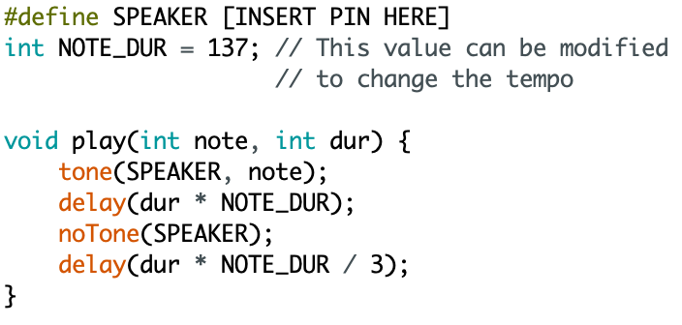
tone() and noTone()
Copy the code for play() into your program and change the #define statement to the pin with your speaker.
Play will play a note at the inputted frequency and duration.
We will give you all notes and their corresponding pitches here in pitches.h.
Notes:
Play is a function you can add to your program and call that function in your loop!

Slide 33
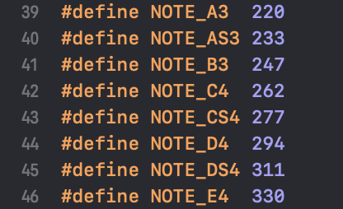
pitches.h
Download and put in same folder as your program
Use #include “pitches.h” at top of program
Also: basicpitches.h
All note pitches are labelled
Ex: NOTE_C4 is 262 Hz aka middle C
Now, we can use for example:
play(NOTE_C4, 4);
Play middle C for 4 note lengths
Notes:
OPTIONAL SLIDE: This can be covered in spec notes

Slide 34

Your job: Part 1 - Sound
Write a song (minimum 10 notes) using play( ) and play it through your speaker.
Get creative!
Example song here: Despacito
Copy-paste into your code and call Despacito() in loop() to use!
No experience with music? No problem. Here are some songs with labelled notes.
Notes:
Bryan

Slide 35
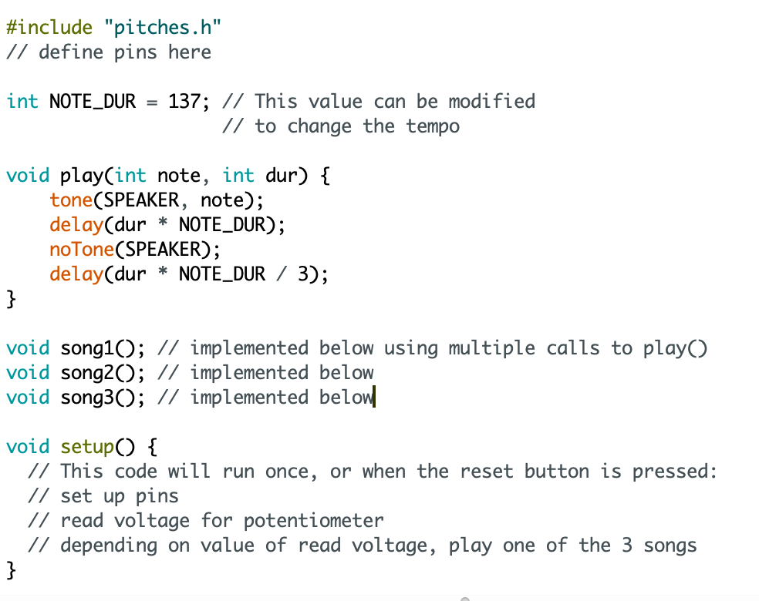
Your job: Part 2 - Interface
Implement the potentiometer interface.
Depending on where the dial is turned, a different song will play when you press RESET.
Be able to switch between at least 3 songs.
This means you will have to add more music!
Pseudocode pictured to the left. You will need to use several if statements.
Notes:
Bryan

Slide 36
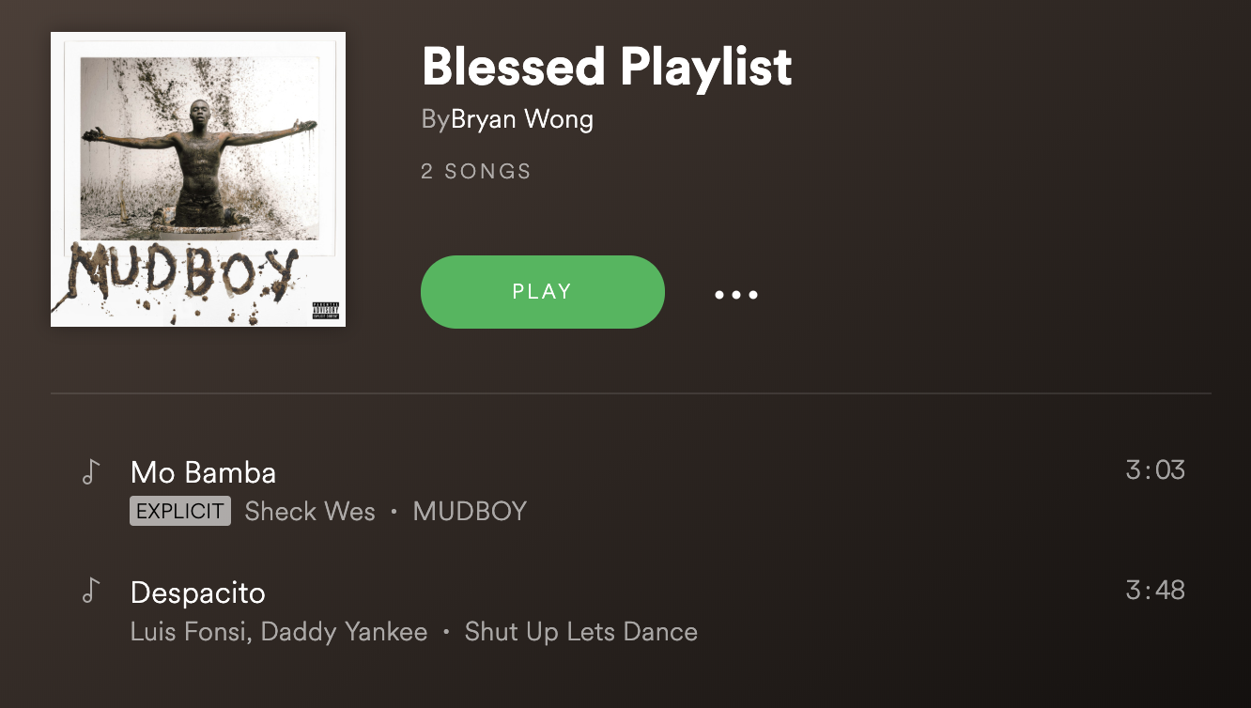
Your job: Part 3 - Display
Implement an LED display that lets the user know what song will be played when RESET is pressed
EX: Blue = Despacito,
Red = Mo Bamba
Hint: setup( ) happens once per reset,
loop( ) repeats itself infinitely
There are a few different ways to go about this.
Could make LED brightness change or use multiple LEDs to correspond to different songs
Notes:
Bryan

Slide 37


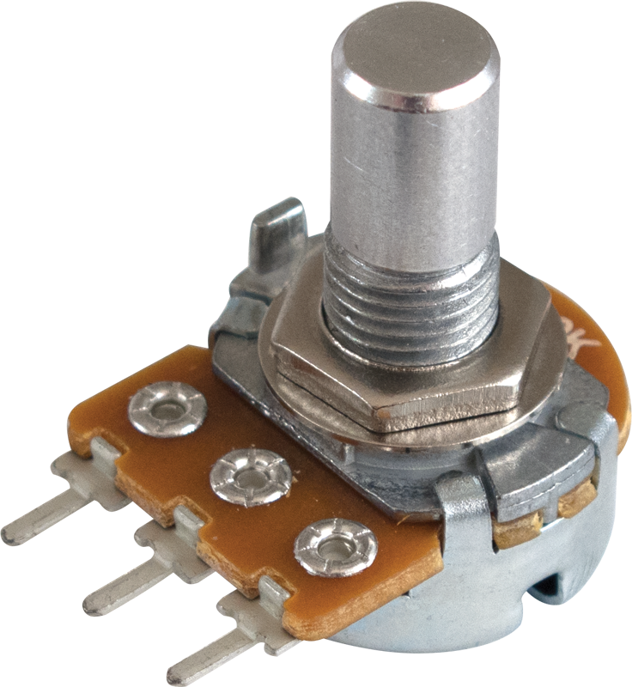
To Recap:
Microcontrollers are a great way to link several different systems
(the speaker, the potentiometer interface, and the display)
Analog and Digital signals are different, and it is important to use the right type for the job
We can simulate an analog signal output using digital signals by using PWM and changing the duty cycle
The frequency of the PWM signal can be changed to modify the pitch of the note played through a speaker, creating music!
Notes:
Bryan

Slide 38
Prototype of End Result

Slide 39

Project Deadlines
Arduino iPod will be due:
Monday Students: 10/18
Thursday Students: 10/14
More project details here & here
Come to our LAB HOURS for help!
Check out lab hours for:
(Mon): Ryuichi, Rachel, or
(Thur): Wesley, Paula

Slide 40

Thank You!

